Slide 1


Radiomics-Based Classification of Brain Tumor Subtypes Using Machine Learning
Group 1: Austin Cherian, Natalie Ellis, Fadwa Elfeituri, Stephen Payne

Slide 2


Background
Gliomas are the most common malignant primary brain tumors, arising from glial cells that support neurons [1].
Subtypes are defined by both histology and molecular markers [2].
Accurate classification is critical for guiding treatment and predicting survival [2].
Notes:
"Gliomas are the most prevalent type of malignant primary brain tumors, originating from glial cells that support neuronal function.
Subclassification of these tumors is based on both histopathological features and molecular biomarkers, including mutations and chromosomal alterations.
Accurate subtype classification is critical for informing therapeutic decisions and predicting clinical outcomes. As such, developing reliable tools for distinguishing between glioma subtypes has significant implications for personalized treatment planning and prognosis

Slide 3
Cancer Subtypes (WHO Classification):
Glioblastoma (GBM):
The most aggressive and lethal form of glioma (WHO Grade 4).
Characterized by rapid growth, necrosis, and microvascular proliferation.
Median survival is ~15 months despite treatment [3].
Astrocytoma (IDH-mutant):
Derived from astrocytes; occurs across a spectrum of grades.
IDH mutation is a favorable prognostic marker.
Slower progression than GBM, but still infiltrative [4].
Oligodendroglioma:
Arises from oligodendrocytes; generally slow-growing.
Defined by IDH mutation and 1p/19q co-deletion.
Better prognosis and chemosensitivity than other gliomas [5].
Notes:
GBM is the most aggressive, with poor survival despite treatment.
Astrocytoma, especially IDH-mutant, grows more slowly and has a better prognosis.
Oligodendroglioma is typically slow-growing and responds well to therapy, with the best overall outcome among the three.

Slide 4
Project Objective & Significance
Develop interpretable machine learning models that classify brain tumor subtypes—Glioblastoma, Astrocytoma, and Oligodendroglioma—based on radiomic features
Radiomics offers a non-invasive alternative by extracting high-dimensional features from MRI scans, enabling automated, image-based classification of glioma subtypes.

Slide 5
Data Sources:
TCGA (The Cancer Genome Atlas): Precomputed radiomic features + clinical labels
REMBRANDT: T1-weighted MRI scans + segmentation masks
Tumor classes:
GBM, Oligodendroglioma, Astrocytoma
Notes:
Stephen

Slide 6
Methodology
Classification Strategy: One-vs-Rest (OvR)
Final label chosen based on the highest probability across models
Tailored algorithms per class:
  GBM → XGBoost
  Oligo → Linear SVM
  Astrocytoma → Gradient Boosting
Notes:
Austin
The One-vs-Rest strategy is a decomposition method that trains a separate binary classifier for each class, allowing each model to learn to distinguish one specific tumor type from the rest. During prediction, each classifier outputs a probability score, and the final class label is selected based on the highest probability across all models [9]. This modular approach allowed us to tailor the choice of algorithm to the characteristics of each tumor subtype and interpret feature importance independently per class.

Slide 7
Methodology
Extracted 107 radiomic features from segmented MRI scans using PyRadiomics
Step 1:
Feature Extraction from REMBRANDT
Features saved to structured CSV for inference
Notes:
Austin

Slide 8
Methodology
Preprocessing Steps
Merged TCGA radiomic features with clinical labels
Filtered for target tumor types only (GBM, Oligo, Astro)
Removed missing or non-numeric, values
Dropped diagnostic metadata
Applied z-score normalization
Step 2:
Training on TCGA
Notes:
Austin

Slide 9
Methodology
Training & Evaluation
Performed grid search to optimize hyperparameters
Applied 5-fold stratified cross-validation
Evaluated using F1 score
Retained best model per class with optimized hyperparameters for final multiclass system
Step 2:
Training on TCGA
Notes:
Austin

Slide 10
Methodology
Preprocessing Steps
Used same preprocessing pipeline on testing data for consistency
  Integrated ground truth tumor labels by merging clinical data
  Removed non-numeric columns
(Diagnostic metadata, Rows with missing values, Ensured feature names and order matched TCGA dataset)
  Applied the same StandardScaler used during TCGA training
Step 3:
Preparing REMBRANDT for Testing
Notes:
Austin

Slide 11
Methodology
Step 4:
Evaluation Metrics
Compared predicted vs. ground truth labels
Assessed performance using:
  Accuracy, Precision, Recall, F1 Score
  generated Confusion matrix and ROC curves
  plotted Feature importance for interpretability
REMBRANDT Model Testing
Applied trained OvR classifiers to processed REMBRANDT features
Each model generated a class probability score
Final label assigned based on highest probability across models
Notes:
Austin

Slide 12
Methodology
Additional Step
Combined TCGA + REMBRANDT into one dataset using UNION join to improve generalizability
Aligned feature columns, standardized labels, and applied z-score normalization
Unified Training & Evaluation
Notes:
Austin

Slide 13
Methodology
Training Process
Filtered to include GBM, Oligodendroglioma, Astrocytoma only
Split into stratified training and test sets
Trained OvR classifiers:
  XGBoost (GBM), Linear SVM (Oligo), Gradient Boosting (Astro)
Tuned each using grid search + cross-validation
Additional Step
Unified Training & Evaluation
Notes:
Austin

Slide 14
Methodology
Evaluation
Selected final class by highest probability across models
Assessed with accuracy, F1 score, confusion matrices, ROC curves
Visualized feature importances per class for interpretability
Additional Step
Unified Training & Evaluation
Notes:
Austin

Slide 15
Results - Performance Metrics
Step 2: Training on TCGA
Best Performance:
GBM → F1 Score: 0.74, Recall: 0.83, AUC: 0.82
Astrocytoma → Moderate performance
Oligodendroglioma → Weakest performance
Classifier | Accuracy (mean ± std) | Precision (mean ± std) | Recall (mean ± std) | F1 Score (mean ± std)
GBM (XGBoost) | 0.812 ± 0.036 | 0.833 ± 0.040 | 0.911 ± 0.059 | 0.868 ± 0.028
Oligodendroglioma (SVM) | 0.791 ± 0.072 | 0.472 ± 0.088 | 0.587 ± 0.232 | 0.489 ± 0.067
Astrocytoma (Gradient Boosting) | 0.866 ± 0.048 | 0.519 ± 0.326 | 0.370 ± 0.218 | 0.414 ± 0.234
Notes:
natalie
based on cross-validation performance of tcga dataset - base classifiers - distinguishing its class for others
three different models - xgboosrt, svm, gradient
XGBoost achieved the highest F1 score (0.868 ± 0.028) for GBM, indicating strong performance in capturing the dominant class. Astrocytoma's Gradient Boosting classifier achieved the highest accuracy (0.866 ± 0.048), but with lower recall (0.370 ± 0.218). The Oligodendroglioma SVM classifier performed moderately across all metrics. The F1 scores for each classifier, in order of performance, were: GBM (0.868), Oligodendroglioma (0.489), and Astrocytoma (0.414).

Slide 16
Results - Performance Metrics
Step 4: REMBRANDT Test
Overall Accuracy: 43%
Astrocytoma → Best Performance
F1 Score: 0.54 (highest)
AUC: 0.50
GBM: Moderate Performance
F1 Score: 0.39
AUC: 0.48
Oligodendroglioma → Lowest Performance:
F1 Score: 0.0
AUC: 0.67
Frequently misclassified despite a decent AUC
Class | Precision | Recall (Sensitivity) | Specificity | F1 Score | Support
GBM | 0.35 | 0.44 | 0.625 | 0.39 | 18
OLIGODENDROGLIOMA | 0.00 | 0.00 | 1.000 | 0.00 | 12
ASTROCYTOMA | 0.49 | 0.61 | 0.400 | 0.54 | 28
Macro Avg | 0.28 | 0.35 | — | 0.31 | 58
Weighted Avg | 0.34 | 0.43 | — | 0.38 | 58
Accuracy | — | — | — | 0.43 | 58
Notes:
natalie
This table presents the performance metrics of the one-vs-rest classifiers tested exclusively on the REMBRANDT dataset after being trained on TCGA data.
The overall accuracy on the test set was 0.43, and the weighted average F1-score, which accounts for class imbalance, was 0.38. The macro average F1-score across all classes, regardless of support, was 0.31, highlighting the uneven performance across tumor subtypes. Among the three tumor classes, Astrocytoma had the highest individual F1-score (0.54) and recall (0.61), then GBM, then oligo
Precision = 0.00: None of the predicted samples were classified as Oligodendroglioma.
Recall = 0.00: The model failed to correctly identify any of the 12 actual Oligodendroglioma cases.
F1 Score = 0.00: Since both precision and recall are 0, the F1 score (their harmonic mean) is also 0. This reflects a complete classification failure for this class.
Specificity = 1.00: The model correctly identified all non-Oligodendroglioma cases as not Oligodendroglioma. In other words, there were no false positives for this class.
AUC -> oligo did well

Slide 17
Results - Performance Metrics
Additional Step: Combined Dataset
Overall Accuracy: 60%
GBM → Best Performance
F1 Score: 0.74 (highest)
Recall: 0.83
Astrocytoma: Moderate Performance
F1 Score: 0.40
Balanced precision and recall
Oligodendroglioma → Lowest Performance:
F1 Score: 0.20
Recall: 0.12, despite high specificity (0.971)
Class | Precision | Recall (Sensitivity) | Specificity | F1-Score | Support
GBM | 0.67 | 0.83 | 0.444 | 0.74 | 24
Oligodendroglioma | 0.50 | 0.12 | 0.971 | 0.20 | 8
Astrocytoma | 0.40 | 0.40 | 0.812 | 0.40 | 10
Overall Accuracy | — | — | — | 0.60 | 42
Macro Avg | 0.52 | 0.45 | — | 0.45 | 42
Weighted Avg | 0.57 | 0.60 | — | 0.56 | 42
Notes:
natalie
This table summarizes the classification performance on the combined test dataset, highlighting the model’s accuracy of 0.60. Among individual classes, GBM achieved the highest F1-score of 0.74 with strong recall (0.83), while Oligodendroglioma performed the worst, with an F1-score of 0.20 due to very low recall (0.12), despite high specificity (0.971). Astrocytoma showed moderate performance, with balanced precision and recall, resulting in an F1-score of 0.40. The macro-averaged F1-score was 0.45, indicating variability across classes, whereas the weighted average F1-score, accounting for class imbalance, was 0.56.

Slide 18
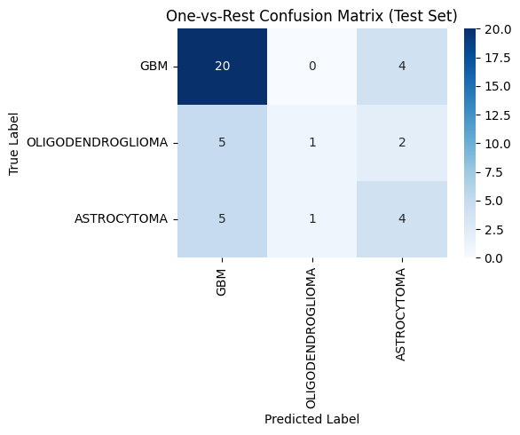
Results - Confusion Matrix
Additional Step: Combined Dataset
GBM was the most accurately predicted class (20 out of 24 cases correctly identified)
Oligodendroglioma showed the highest misclassification rate
Astrocytoma and Oligodendroglioma often misclassified as GBM
Reflects class imbalance and overlapping radiomic signatures
Notes:
natalie
Figure 3 shows the One-vs-Rest confusion matrix on the combined test set. GBM was the most accurately predicted class, with 20 out of 24 cases correctly identified. Misclassification was most pronounced for Oligodendroglioma and astro, which was often confused with GBM - true label others, classified instead as the other GBM. reflecting class imbalance and possibly less distinctive radiomic features.

Slide 19
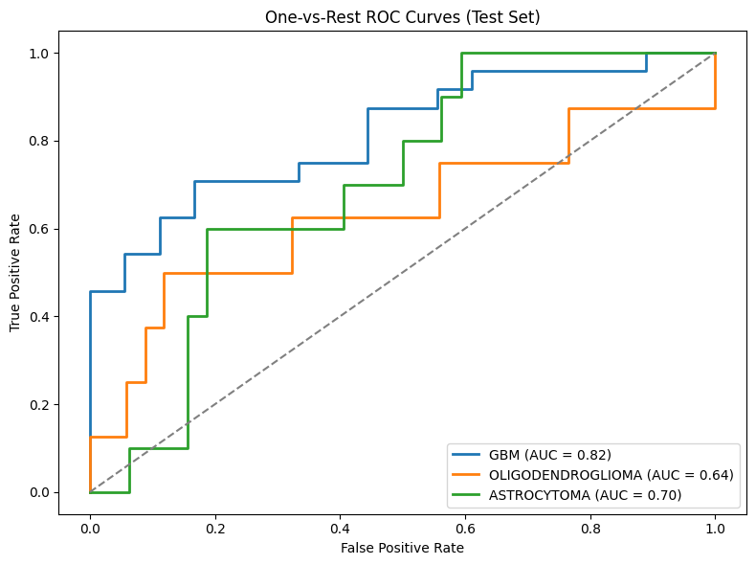
Results - ROC Curve
Additional Step: Combined Dataset
GBM achieved the highest AUC: 0.82
Astrocytoma AUC: 0.70 (Moderate discriminative ability)
Oligodendroglioma AUC: 0.64 (Despite poor F1 score, model ranked cases fairly well)
Notes:
natalie
Figure 4 displays the ROC curves for each class under the combined evaluation. GBM achieved the highest AUC (0.82), followed by Astrocytoma (0.70), and Oligodendroglioma (0.64). While Oligodendroglioma had a poor F1 score and was rarely predicted correctly, the ROC curve indicates that its model still assigned relatively higher probabilities to true positive cases. However, when all three models competed in the One-vs-Rest setup, Oligodendroglioma predictions were typically not the highest among the three, and therefore it was rarely selected as the final class label. This explains the discrepancy between its AUC and its low F1 performance.

Slide 20
Results - Feature Importances
Top Predictive Features (TCGA Training Set)
GBM: Shape and texture features dominate
Top features: SurfaceVolumeRatio, MeshVolume
Oligodendroglioma: Texture features indicating calcification patterns
Top features: SizeZoneNonUniformityNormalized, RunLengthNonUniformity
Astrocytoma: Mix of shape and first-order statistics
Top features: SurfaceVolumeRatio, SurfaceArea
First-order statistical metrics such as Kurtosis and Minimum
Notes:
Stephen

Slide 21
Results - Feature Importances
Top Predictive Features (Combined Data Set)
GBM: Shape and texture features dominate
Top features: NGTDM_Coarseness, MinorAxisLength, Sphericity
Oligodendroglioma: Texture features reflect calcification patterns
Top features: RunLengthNonUniformity, ZonePercentage, SizeZoneNonUniformityNormalized
Astrocytoma: Combination of shape and first-order features
Top features: SurfaceVolumeRatio, Skewness, Kurtosis
Notes:
Stephen

Slide 22
Discussion - GBM
NGTDM Coarseness: Captures rapid voxel intensity shifts; reflects mottled texture from necrosis and microvascular proliferation.
Shape Metrics: High surface-to-volume ratio, low sphericity, elongated shape—indicate invasive, lobulated tumor growth along white matter tracts.
Low Gray-Level Run Emphasis: Detects long stretches of dark voxels; consistent with central necrosis.
Notes:
Glioblastoma stands out because of its aggressive nature, and that shows clearly in its radiomic features composed of both texture and shape-based features
One of the strongest predictors was NGTDM Coarseness. This captures rapid changes in intensity between nearby pixels. It reflects the patchy, mottled look we often see in GBM due to tissue death and abnormal blood vessels—both classic signs of this tumor.
Shape features were also important. GBM tumors often have a high surface-to-volume ratio, are less spherical, and show an elongated shape. These patterns suggest the tumor is spreading in a lobulated and infiltrative way along the brain’s white matter—something that matches is known from pathology and also relates to worse survival.
Lastly, the model picked up Low Gray-Level Run Emphasis, which highlights long stretches of dark areas on the scan. That matches the central necrosis we often see in GBM.

Slide 23
Discussion - Oligodendroglioma
Dominated by texture features linked to calcification
Run/Zone non-uniformity reflects patchy calcified areas
Low-gray-level emphasis captures abundance of dark voxels
Patterns match known 1p/19q codeletion phenotype
Notes:
Oligodendroglioma was mainly characterized by texture features, which aligns well with what we know histologically—these tumors often show uniform cellularity and coarse calcifications.
One standout feature was Run-Length Non-Uniformity, which captures variation in how long similar intensity regions last. This helps detect the mix of calcified and non-calcified areas—something typical of this tumor type.
Another important one was Size-Zone Non-Uniformity, which measures how patchy or scattered the homogeneous zones are—again reflecting those uneven calcified regions.
The model also picked up Zone Percentage and Low Gray-Level Emphasis, which signal a concentration of darker areas in the image—another radiologic sign of calcification.
These features together align with the known 1p/19q codeletion phenotype, a key molecular marker for Oligodendroglioma.

Slide 24
Discussion - Astrocytoma
Mixed radiomic signature reflects Astrocytoma’s diffuse growth and variable density
Shape features (high surface-to-volume ratio, low sphericity) indicate irregular, finger-like infiltration along white matter
First-order features (skewness, kurtosis) capture asymmetric intensity from cystic change, edema, or necrosis
Higher-order texture features (GLCM cluster shade, GLSZM zone entropy) reveal tissue heterogeneity in higher-grade cases
Notes:
Astrocytoma showed a mixed radiomic signature, which reflect its diffuse and variable growth pattern.
Shape features—like a high surface-to-volume ratio and low sphericity—highlight the tumor’s irregular, finger-like infiltration along white matter. This is a classic radiologic pattern for astrocytomas.
We also saw important first-order features such as skewness and kurtosis, which point to asymmetric intensity patterns—often linked to cysts, swelling, or areas of necrosis.
Finally, higher-order texture features like GLCM cluster shade and GLSZM zone entropy captured the tissue heterogeneity we typically see in more aggressive, higher-grade cases.
So, overall, the model picked up on both the spread and structural complexity of astrocytoma.

Slide 25
Summary and Key Takeaways
Radiomic features offer interpretable, non-invasive biomarkers
Each tumor subtype has a distinct radiomic signature
Combining datasets improves robustness and relevance
Features identified are consistent with clinical manifestation of disease
Notes:
Stephen

Slide 26
REFERENCES
Louis, D. N., et al. (2021). WHO Classification of Tumours of the Central Nervous System (5th ed.). IARC. https://doi.org/10.1007/978-3-030-86355-
Wesseling, P., & Capper, D. (2018). WHO 2016 classification of gliomas. Acta Neuropathol, 135(4), 581–588. https://doi.org/10.1007/s00401-018-1918-0
Ostrom, Q. T., et al. (2019). CBTRUS Statistical Report. Neuro-Oncology, 21(Suppl 5), v1–v100. https://doi.org/10.1093/neuonc/noz150
Brat, D. J., et al. (2015). Comprehensive, integrative genomic analysis of diffuse lower-grade gliomas. NEJM, 372(26), 2481–2498. https://doi.org/10.1056/NEJMoa1402121
Cairncross, J. G., et al. (2014). Benefit of chemotherapy in 1p/19q-codeleted oligodendrogliomas. NEJM, 370(18), 1694–1701. https://doi.org/10.1056/NEJMoa1404919
Gillies, R. J., Kinahan, P. E., & Hricak, H. (2016). Radiomics: Images are more than pictures. Radiology, 278(2), 563–577. https://doi.org/10.1148/radiol.2015151169
Kickingereder, P., et al. (2016). Radiomic profiling of glioblastoma. Neuro-Oncology, 18(2), 220–227. https://doi.org/10.1093/neuonc/now128

Slide 27
THANK YOU

